Slide 1
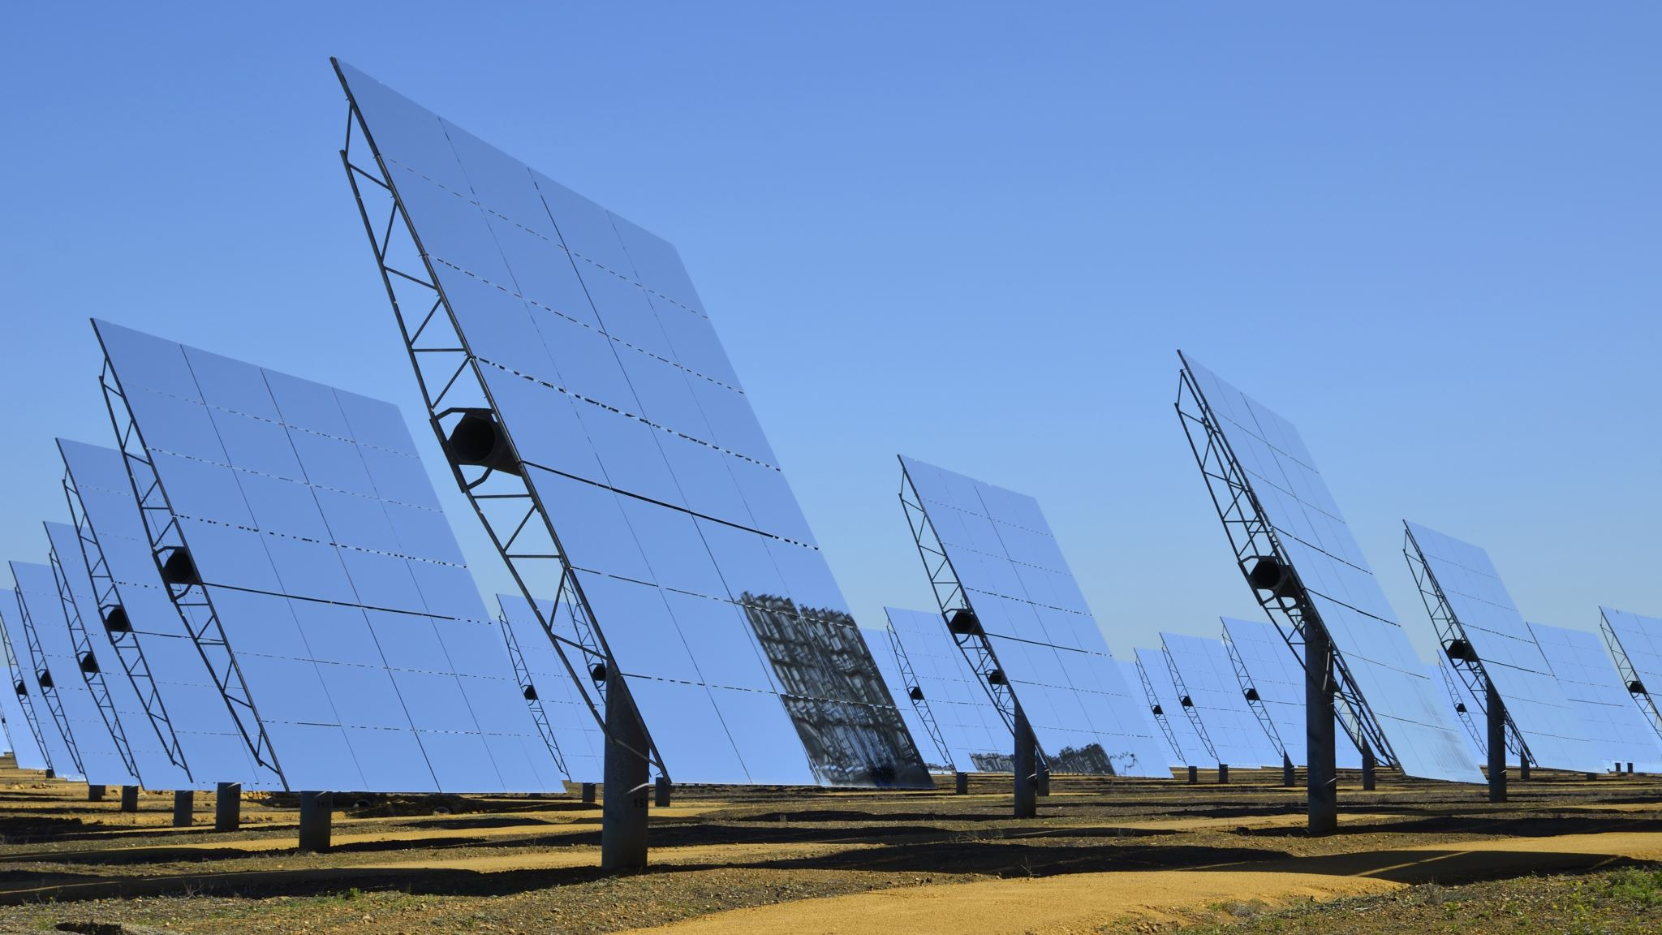
SOLAR POWER SYSTEMS
PREDICTIVE MAINTENANCE

Slide 2
PROBLEM STATEMENT
solar power plants play a crucial role in the transition toward clean energy.
However, maintaining large solar farms is challenging,as breakdowns or inefficiencies can significantly reduce power output and cause financial losses.
Traditionally maintenance schedules of equipment.
The introduction of AI-driven predictive maintenance.

Slide 3
REAL LIFE EXAMPLE
A solar farm in California experienced frequent inventer failures,leading to a 15% reduction in power output during peak hours .
By integrating machine learning algorithms, the company was able to predict inventer failures by analysing historical data from sensors,and energy output.
The predictive model reduced downtime by 30%, increased energy production,and lowered maintenance costs.

Slide 4
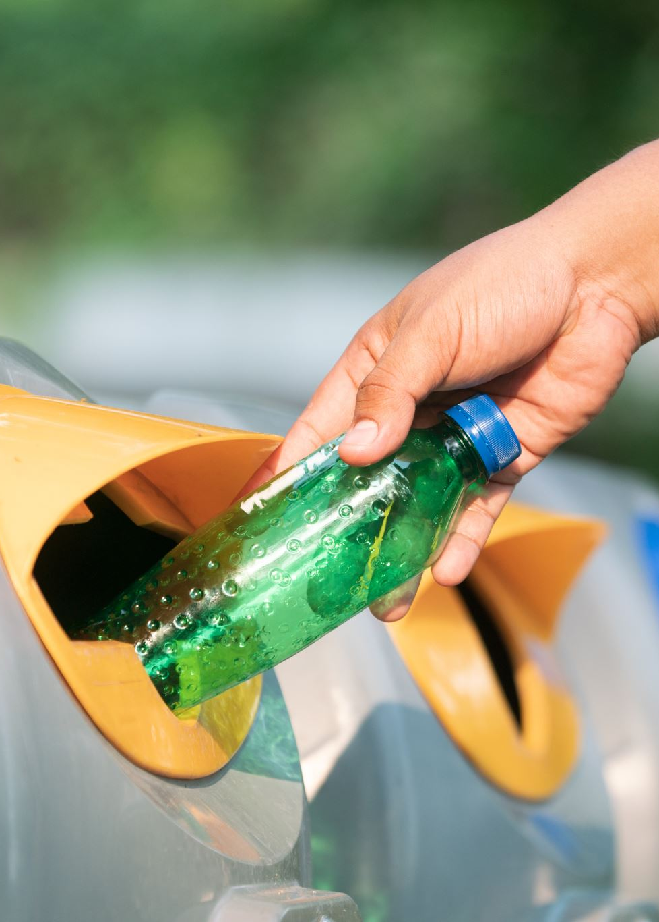
WASTE SORTING USING COMPUTER VISION
PROBLEM STATEMENT
Waste management is a critical aspect of sustainability.
A major problem faced by recycling facilities is the incorrect sorting of waste.
Sorting waste manually is labour –intensive and prone tohuman error.
REAL TIME EXAMPLE
A recycling plant in Sweden implemented a computer vision system that used a convolutional neural network (CNN)to sort recyclable materials such as plastic, glass,and metal from general waste.
DATASET
Different types of waste (plastic,glass,metal,paper) labelled for classification

Slide 5
ENERGY EFFICIENCY IN SMART BUILDING
PROBLEM STATEMENT
Buildings account for nearly 40% of global energy consumption.
Improving energy efficiency in buildings is essential for meeting sustainability targets.
REAL – LIFE EXAMPLE:
A smart office building in Singapore implemented an AI- based energy management system to optimize it’s HVAC ( heating, ventilation,and air conditioning) system.
By analysing real- time occupancy data, Weather forecasts,and historical energy consumption,the system automatically adjusted temperatures and airflow.
DATASET:
You are provided with building energy usage data, occupancy data, and weather conditions over a two – year period

